Slide 1
Midterm on March 27th
Multiple choice questions from the covered chapters.
Approx. 45 min.
Start time: 11:00 !
In our class..

Slide 2
6
Chapter
Managing Human Resources
Copyright ©2011 Pearson Education

Slide 3
The quality of an organization is to a large degree determined by the quality of the people it employs.
Success for most organizations depends on finding the employees with the skills to successfully perform the tasks required to attain the company’s strategic goals.
Staffing and HRM decisions and methods are critical to ensuring that the organization hires and keeps the right people.

Slide 4
Human Resource Management Process (HRM)
The management function concerned with getting, training, motivating, keeping competent employees, and terminating
  The entire process is influenced by the external environment, because whatever happens to an organization ultimately influences what happens to the organization’s human resources.

Slide 5
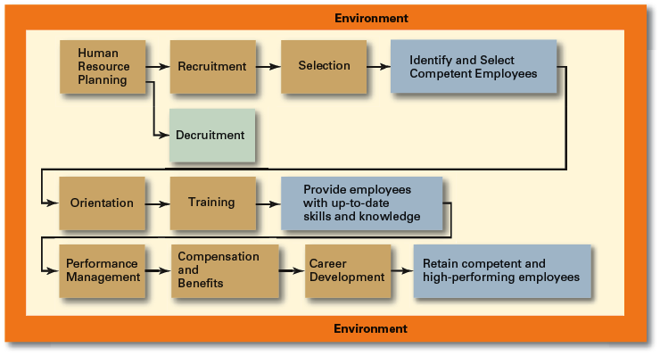
Human Resource Management Process

Slide 6
What Is the Legal Environment of HRM?
Since the mid-1960s, governments has greatly expanded their influence over HRM by enacting a number of laws and regulations:
Regulations Against Workplace Discrimination and Mobbing
Affirmative Action Programs
  Programs that ensure that decisions and practices enhance the employment, upgrading, and retention of members of protected groups

Slide 7
Are HRM Laws the Same Globally?
HRM laws aren’t the same globally. Country laws provide for worker representation in management decisions through
Work Councils
  Groups of nominated or elected employees who must be consulted when management makes decisions involving personnel
Board Representatives
  Employees who sit on a company’s board of directors and represent the interest of employees (For example in Germany)

Slide 8
EU-Equality
In 2000, the European Community (EC) enacted two laws:
Racial Equality Directive: prevent people from being discriminated against on grounds of race and ethnic origin.
Employment Framework Directive: prevent discrimination on grounds of religion or belief, disability, age or sexual orientation.
The two Directives define a set of principles that offer everyone in the EU a common minimum level of legal protection against discrimination.
These laws aim to ensure equal treatment in many aspects of daily life - from the workplace, to issues covering education, healthcare, access to goods and services.
http:// ec.europa.eu/social/home.jsp?langId=en

Slide 9
Labor Code 4857 (2003)
Working period
ARTICLE 63. - The working period is maximum forty five hours a week in general aspect. Unless otherwise agreed, such period is applied by equally assigning it to working days of the week.
The normal weekly working period may be differently assigned to working days of the week without exceeding eleven hours a day, upon agreement of the parties.

Slide 10
Labor Code 4857 (2003)
Age of employment, prohibition on employment of children
ARTICLE 71. - It is prohibited to employ children who did not complete the age of fifteen.
However, those children who have completed the age of fourteen and primary education may be employed in light positions which do not obstruct their physical, mental and moral development and education of those who attend schools.

Slide 11
Labor Code 4857 (2003)
Working during maternity and breast feeding leave
ARTICLE 74. - It is the principle that the female workers should not be caused to work for a period of sixteen weeks in total, eight weeks before and eight week after delivery.
In case of plural pregnancy, such eight-week period before delivery is increased by two weeks.
If, however, health condition allows, the female worker may work until 37th week before delivery, upon approval of physician. In this case, suck worked periods are added to the periods after delivery.

Slide 12
Obligations of employers and workers
ARTICLE 77. - The employers are obliged to take all measures make available all equipment required to ensure labor health and safety at workplaces, and the workers to comply with such measures as taken for labor health and safety.

Slide 13

Turkey and Equal Opportunity
Labor Code 4857
Principle of Equal Treatment
ARTICLE 5. - No discrimination based on language, race, sex, political thought, philosophical belief, religion and similar grounds can be made in the business relation.

Slide 14
Vocabulary is not necessarly neutral
Many expressions’ use emphasize masculine experiences
  “launching a campaign”
  “being a man of his word”
  X give birth to the strategy
Language in workplace may normalize sexist practices

Slide 15
A Contemporary HRM Issue
Sexual harassment is a serious issue in both public and private sector organizations. More than 12,000 complaints are filed each year in U.S Equal Employment Opportunity Commission (EEOC), with more than 15 percent of the complaints filed by males. Settlements in some of these cases incurred a substantial cost to the companies in terms of litigation. It’s estimated that sexual harassment is the single largest financial risk facing companies today
Sexual Harassment is any unwanted action or activity of a sexual nature that explicitly or implicitly affects an individual’s employment, performance, or work environment

Slide 16
Sexual Harassment in Turkey
A study of office workers (N=303; 34% male) (Temgilimoğlu & Tahtasakal, 2004)
30 % of males (62.5% reported)
49 % of females (91.1% reported)

Slide 17
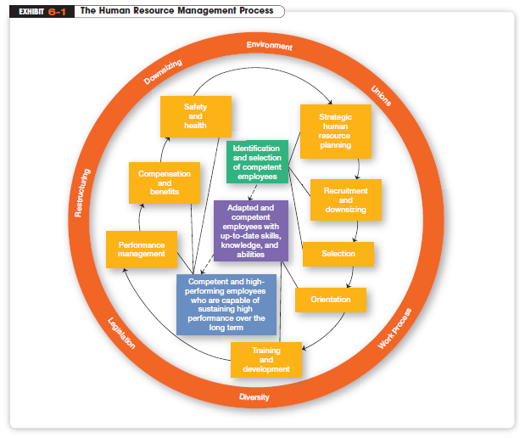

Slide 18
What Is Employment Planning?
The process by which managers ensure they have the right numbers and kinds of people in the right places at the right time
  translates the organization’s mission and goals into an HR plan to allow achieving those goals
Human Resource Inventory
  A report listing important information about employees such as name, education, training, skills, languages spoken, and so forth

Slide 19
Job Analysis
Whereas the human resources inventory is concerned with telling management what individual employees can do, Job Analysis is more fundamental.
  It’s typically a lengthy process, one in which workflows are analyzed and skills and behaviors that are necessary to perform jobs are identified.
  Job Description: A written statement that describes a job
  Job Specification: A written statement of the minimum qualifications that a person must possess to perform a given job successfully

Slide 20
How Do Organizations Recruit?
Recruitment
  Locating, identifying, and attracting capable applicants guided by job analysis
  Applicants can be found by using several sources, including the Internet.
  The source that’s used should reflect the local labor market, the type or level of position, and the size of the organization.

Slide 21
How Do Managers Select Job Applicants?
Screening job applicants to ensure the appropriate candidates are hired: a prediction exercise
  to predict which applicants will be “successful” if hired; that is, who will perform well on the criteria the organization uses to evaluate its employees.
  Reliability: The degree to which a selection device measures the same thing consistently
  Validity: The proven relationship between a selection device and some relevant criteria
Copyright ©2011 Pearson Education

Slide 22
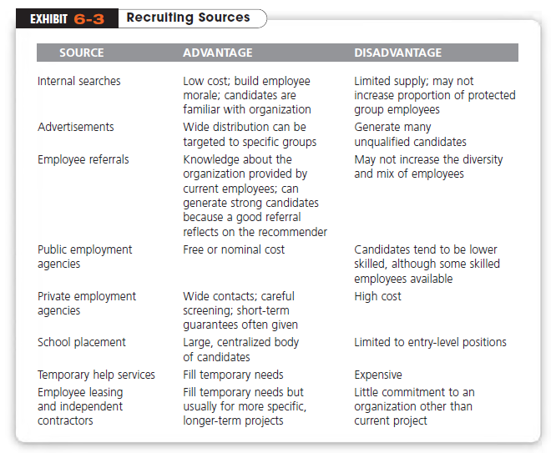

Slide 23
Pre-Employment Testing
Managers can use a number of selection devices to reduce accept and reject errors. The best known devices include
Written tests
  Criticism: they may measure characteristics which are not related to job performance.
Performance-Simulation Tests
  Selection based on actual job behaviors (e.g. assessment center)
Interviews (structured & organized)

Slide 24
Closing the Deal
Providing only details of positive aspects of a job may lead to satisfaction problems later.
To increase job satisfaction among employees and reduce turnover, managers should consider a Realistic Job Preview (RJP)
  A preview of a job that provides both positive and negative information about the job and the company

Slide 25
How Are New Hires Introduced to the Organization?
Orientation
  Introducing a new employee to the job and the organization
Employee Training
  A learning experience that seeks a relatively permanent change in employees by improving their ability to perform on the job
  Thus, training involves changing skills, knowledge, attitudes, or behavior

Slide 26
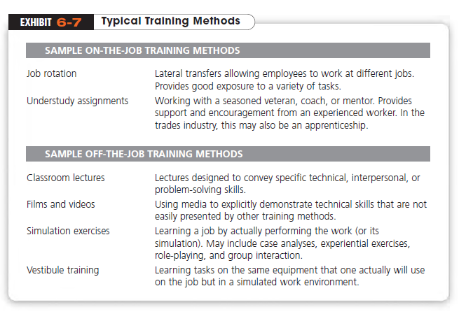

Slide 27
Performance Management System
It’s important for managers to get their employees to achieve performance levels that the organization considers desirable. The formal means of assessing the work of employees is
Performance Management System
  A system that establishes performance standards that are used to evaluate employee performance
Critical Incident -- MBO
360-degree appraisal
  An appraisal device that seeks feedback from a variety of sources for the person being rated
Copyright ©2011 Pearson Education

Slide 28
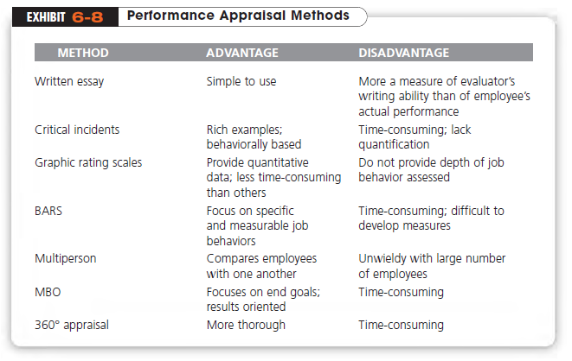
Copyright ©2011 Pearson Education
Notes:
BARS: behaviorally anchored rating scales

Slide 29
How Are Employees Compensated?
Compensation Administration
  The process of determining a cost-effective pay structure that will attract and retain employees, provide an incentive for them to work hard, and ensure that pay levels will be perceived as fair
Skill-based Pay
  A pay system that rewards employees for the job skills they demonstrate
Copyright ©2011 Pearson Education

Slide 30
Compensation (cont.)
Variable Pay
  A pay system in which an individual’s compensation is contingent on performance
Employee Benefits
  Nonfinancial rewards designed to enrich employees’ lives
  e.g. heath insurance, paid time off from work
Copyright ©2011 Pearson Education

Slide 31
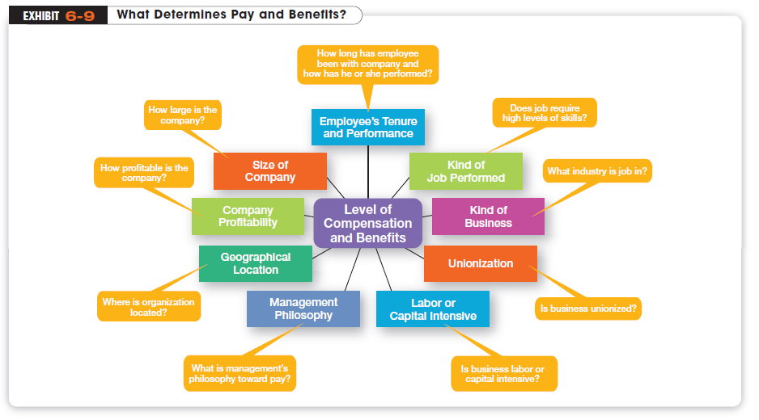
Copyright ©2011 Pearson Education

Slide 32
What Happens If an Employee’s Performance Is Not Up to Par?
If, for some reason, an employee is not meeting his or her performance goals, a manager needs to find out why. If the problem is associated with an employee’s lack of desire to do the job, not with his/her abilities, it becomes a discipline problem.
Discipline: Actions taken by a manager to enforce an organization’s standards and regulations
Employee Counseling: A process designed to help employees overcome performance-related problems

Slide 33
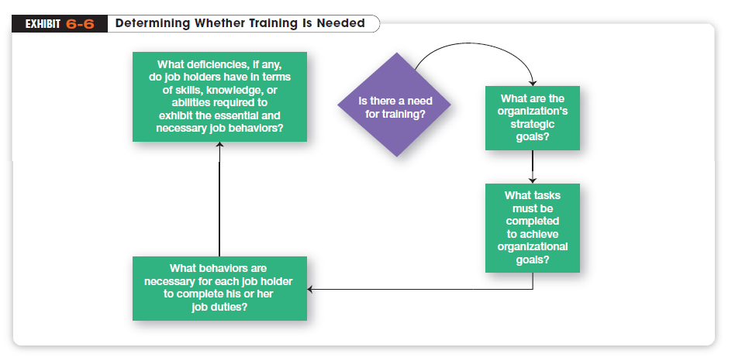

Slide 34
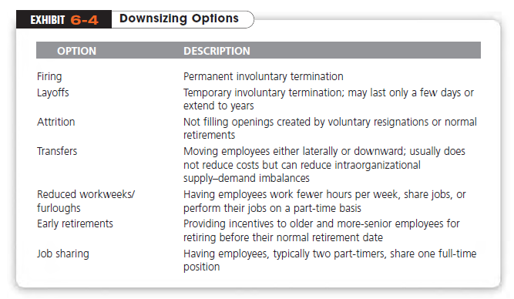
Termination and Downsizing

Slide 35
How to Manage Termination and Downsizing?
Downsizing
  The planned elimination of several jobs in an organization
  Because downsizing typically involves shrinking the organization’s workforce, it’s an important issue in HRM.
Layoff-Survivor Sickness
  A set of attitudes, perceptions, and behaviors of employees who survive layoffs

Slide 36
